Slide 1
What Is Transfer Learning?
Transfer learning is a machine learning (ML) method that reuses a trained model designed for a particular task to accomplish a different yet related task. The knowledge acquired from task one is thereby transferred to the second model that focuses on the new task
Transfer learning captures the lessons learned in one task and applies them to fine-tune another task. Technically, the weights an ML model arrests as it accomplishes ’problem X’ are transferred to a new ’problem Y’.

Slide 2
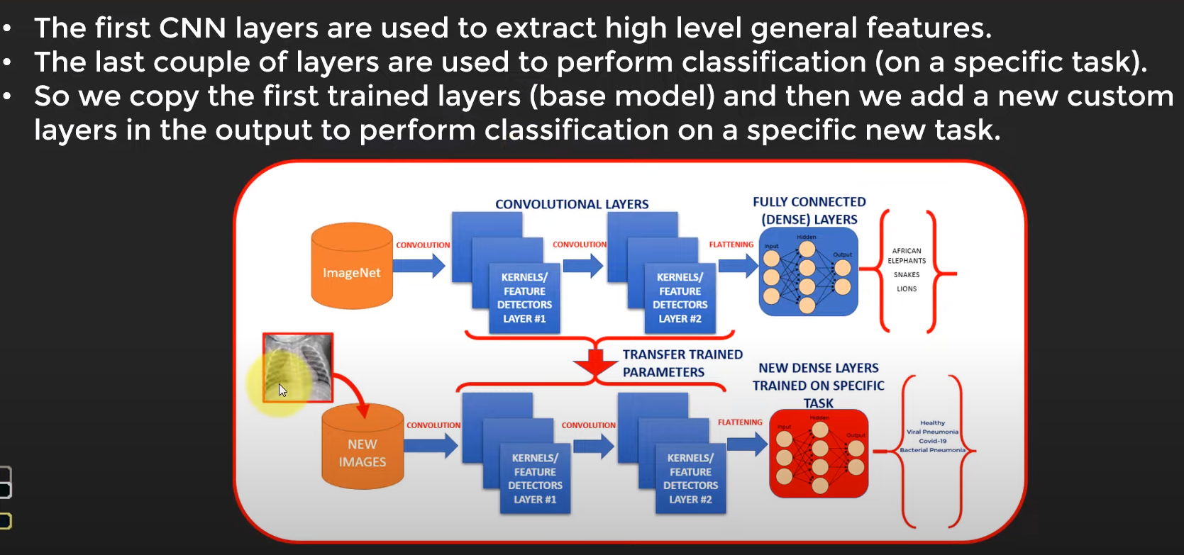
Transfer Learning Process

Slide 3
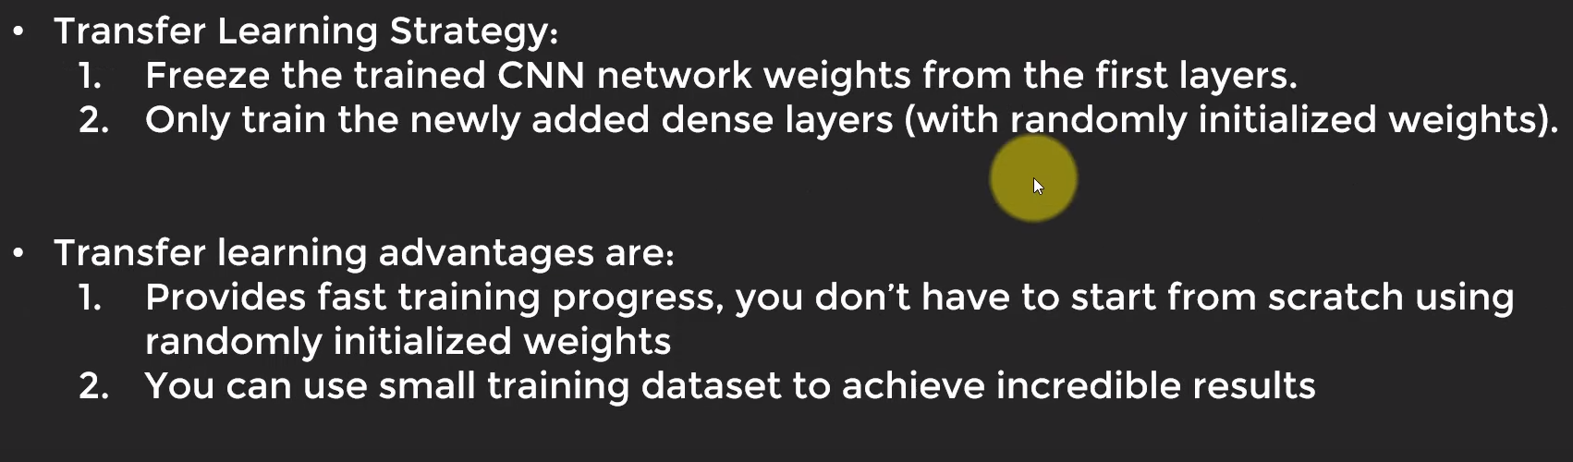

Slide 4
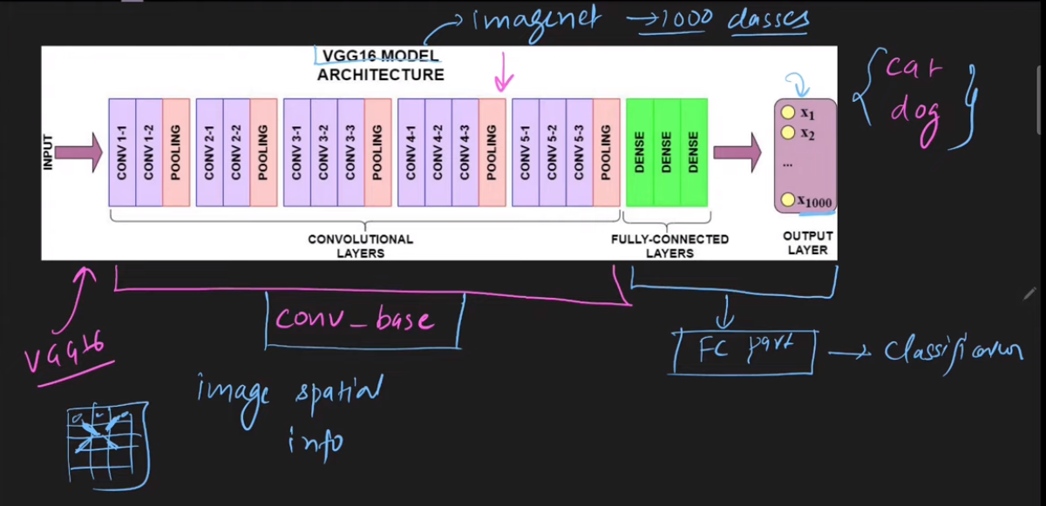

Slide 5
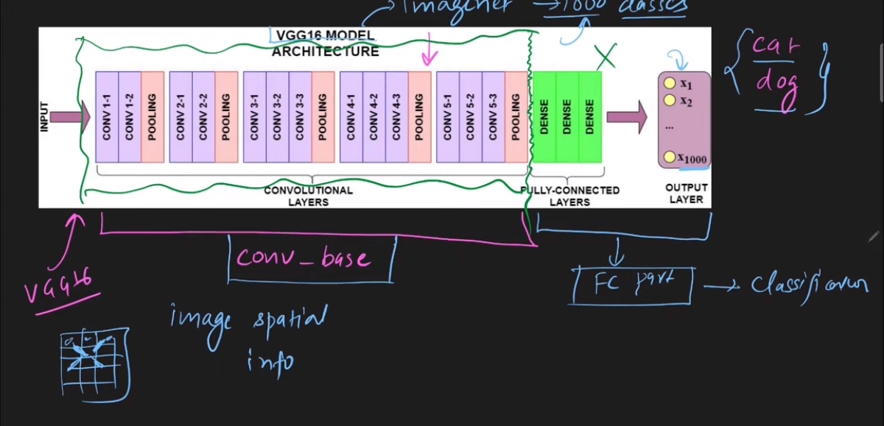

Slide 6
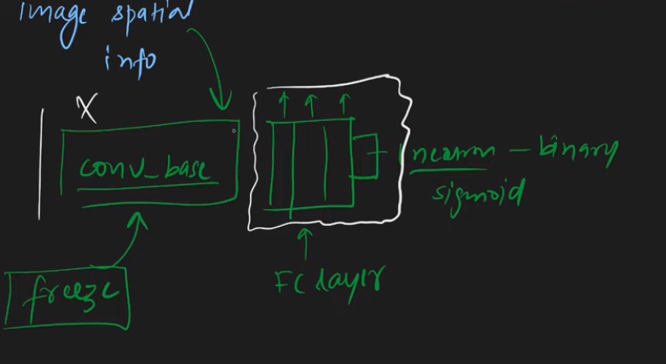

Slide 7
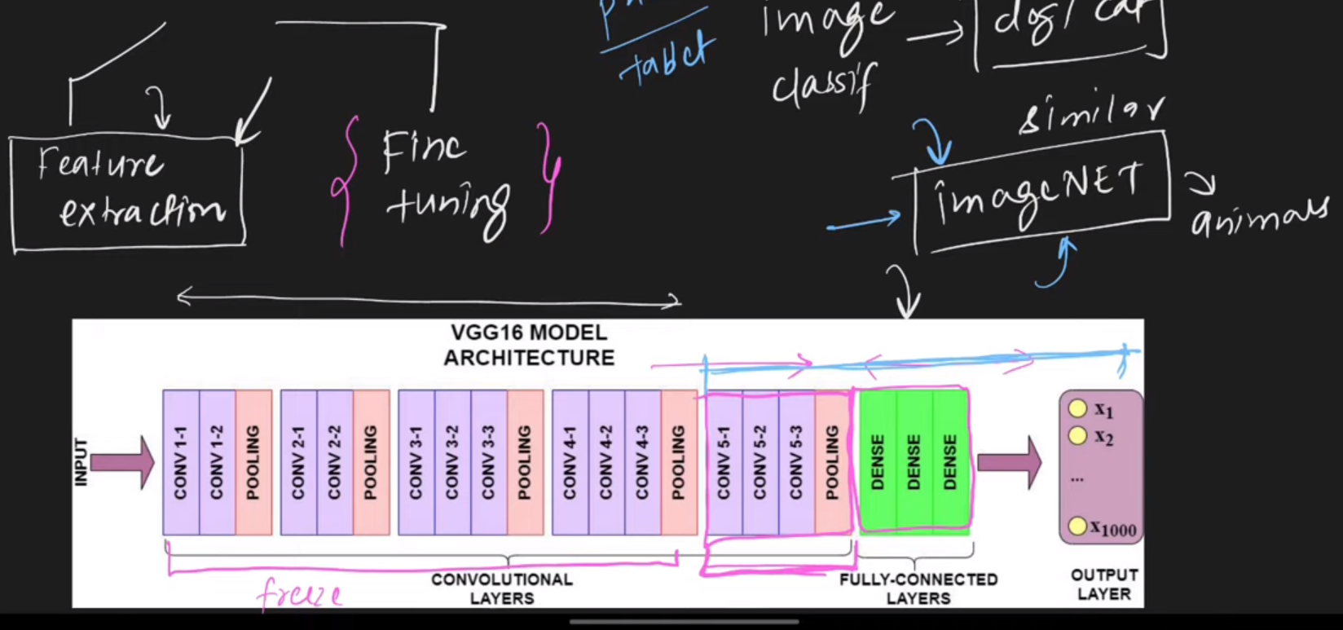
Ways of doing Transfer Learning

Slide 8
Functional API

Slide 9
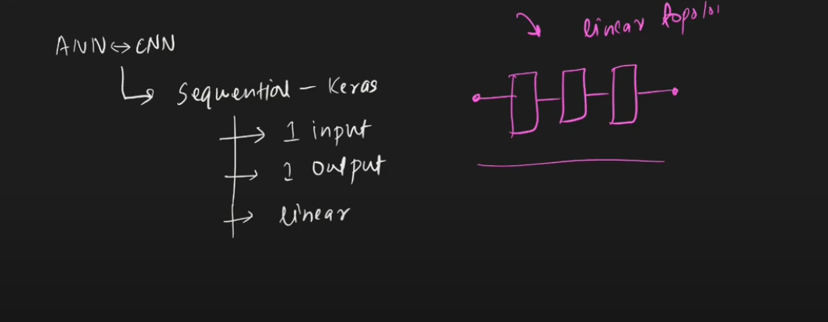
Problem with Sequential Model

Slide 10
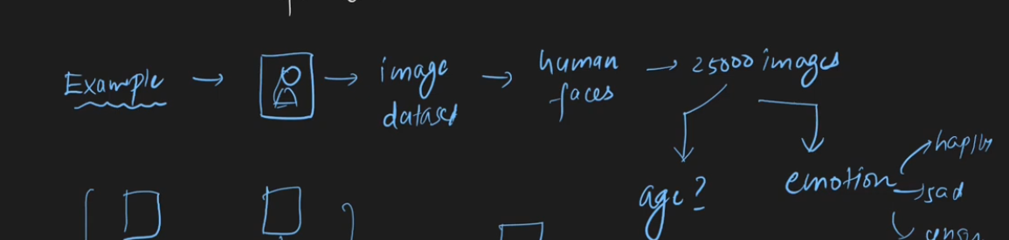
Problem with Sequential Model

Slide 11
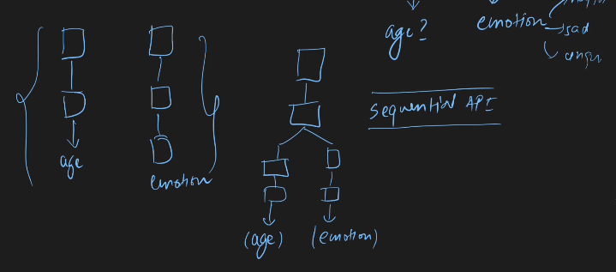

Slide 12
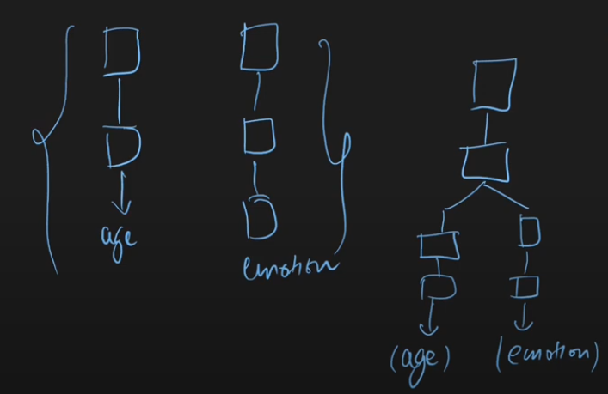

Slide 13
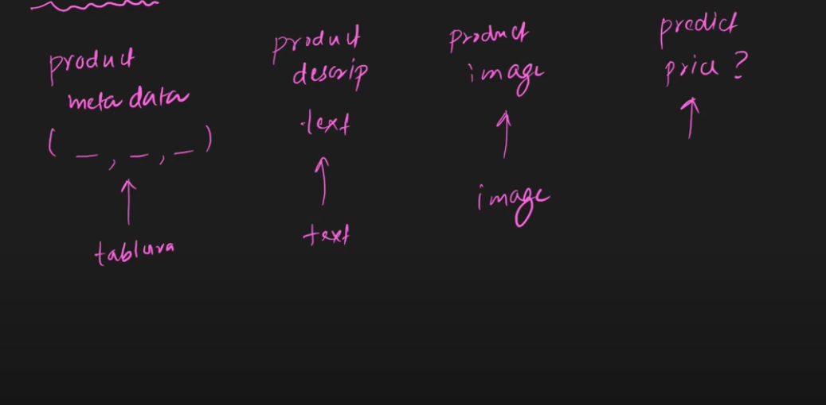
Non-Linear Topology

Slide 14
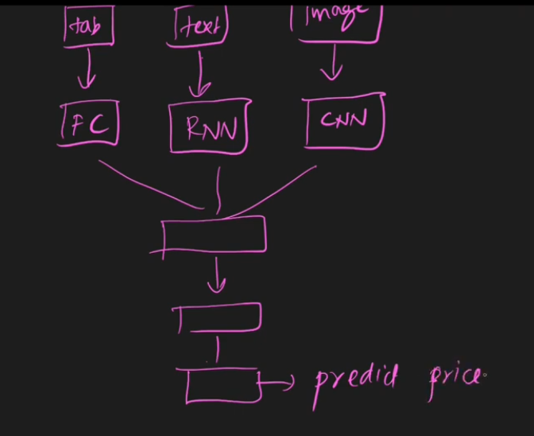

Slide 15
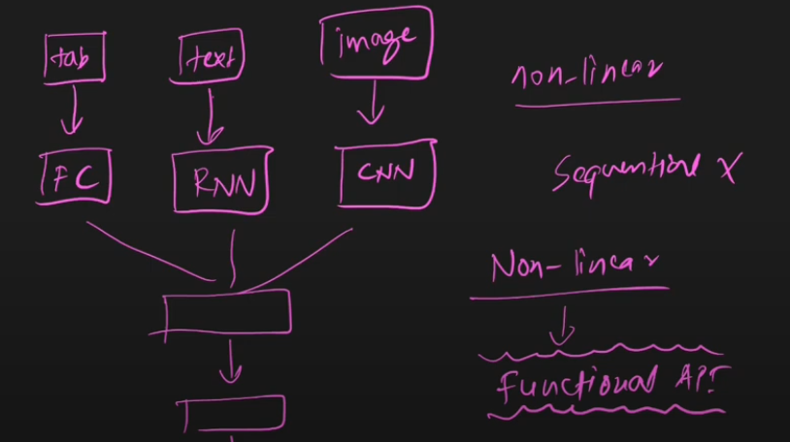

Slide 16
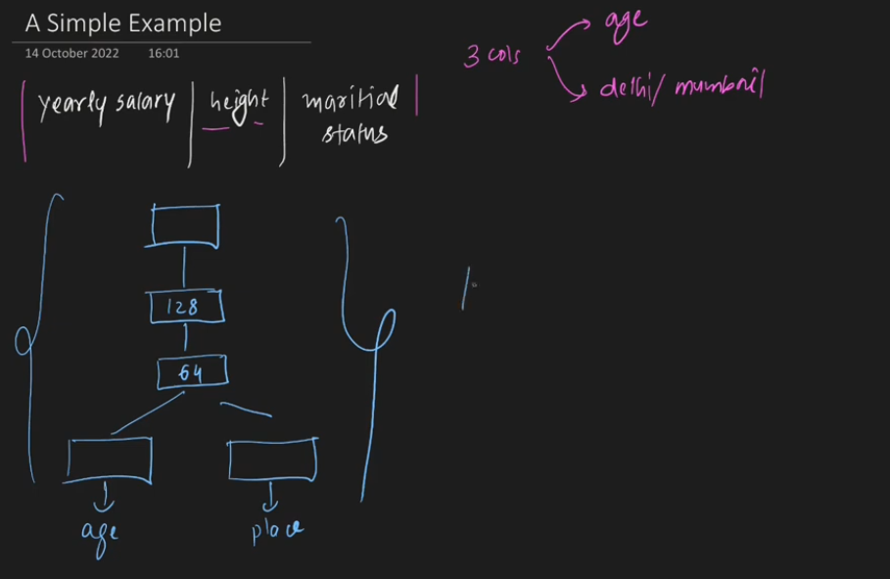

Slide 17
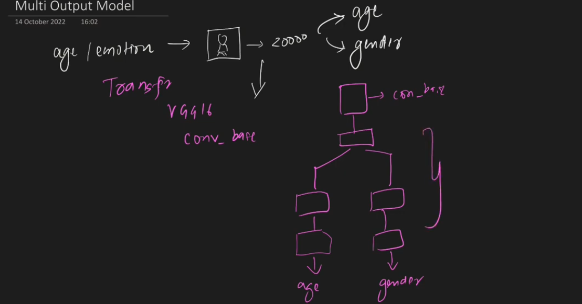

Slide 18
RNN(Re Current Neural Network)

Slide 19
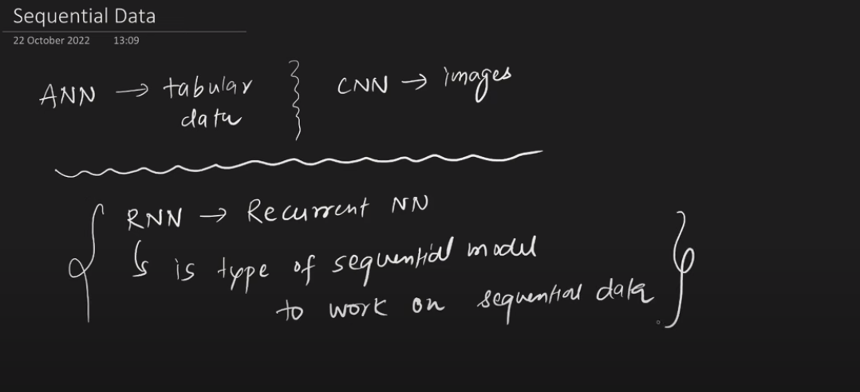
Why RNN(Re Current Neural Network)?

Slide 20
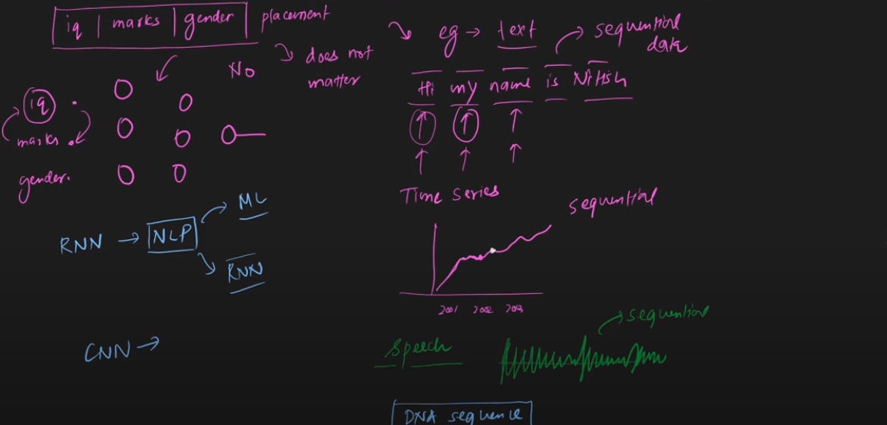

Slide 21
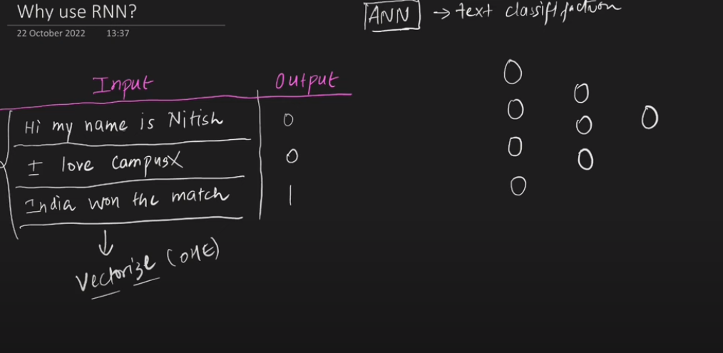

Slide 22
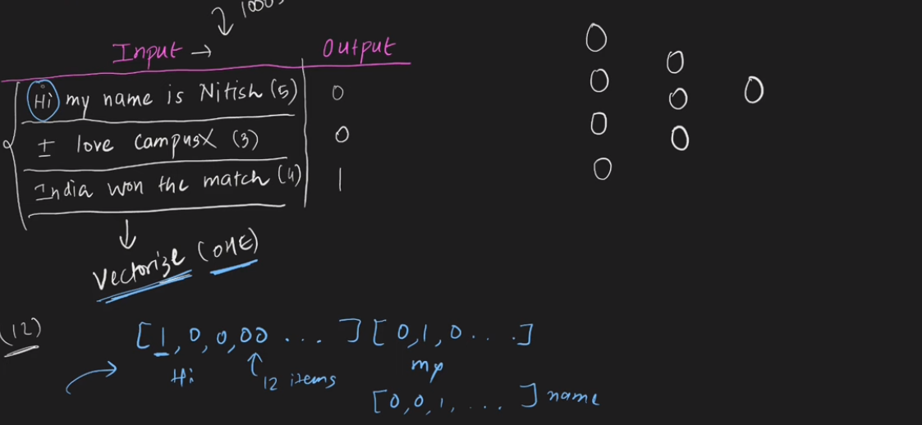

Slide 23
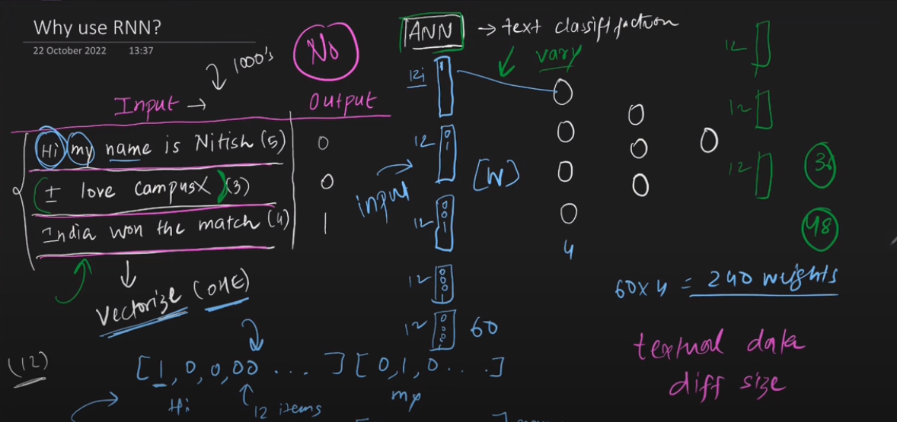

Slide 24
Apply Zero Padding to other vectors which are lesser in Number

Slide 25
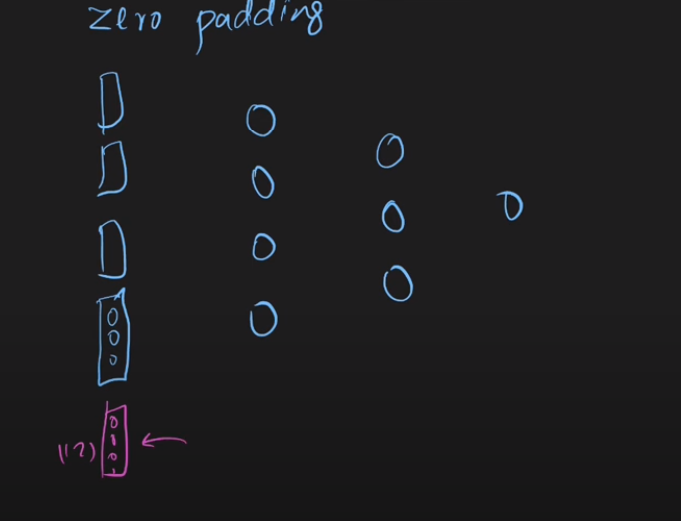

Slide 26
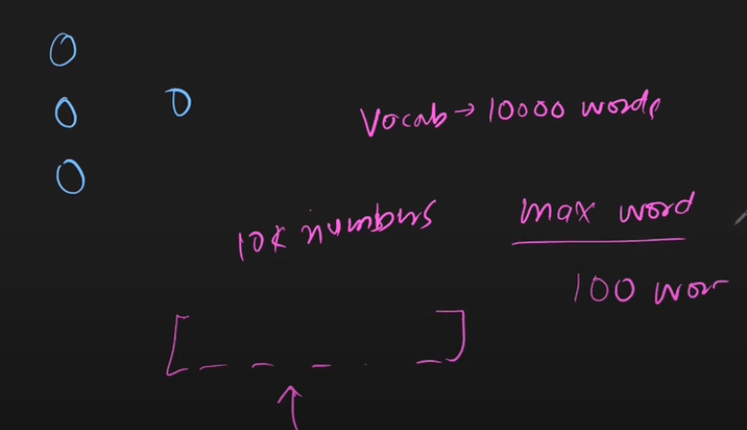
Issue with Zero Padding

Slide 27
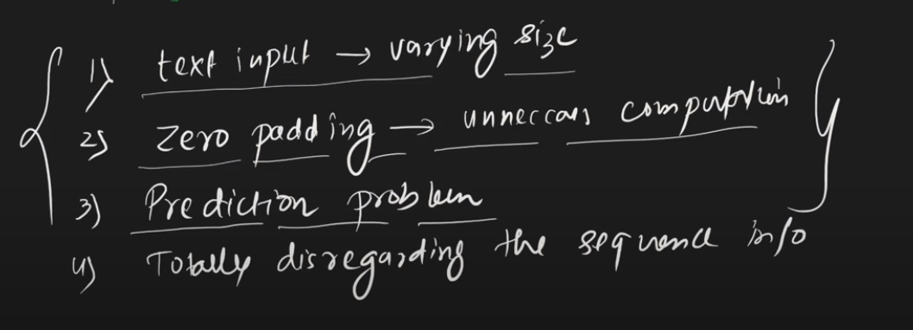

Slide 28
Demo RNN
https://text2data.com/Demo
https://milhidaka.github.io/chainer-image-caption/

Slide 29
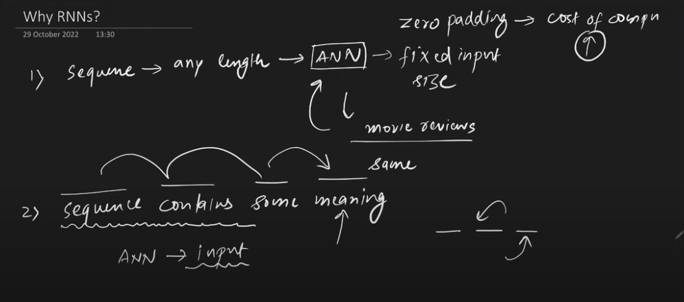

Slide 30
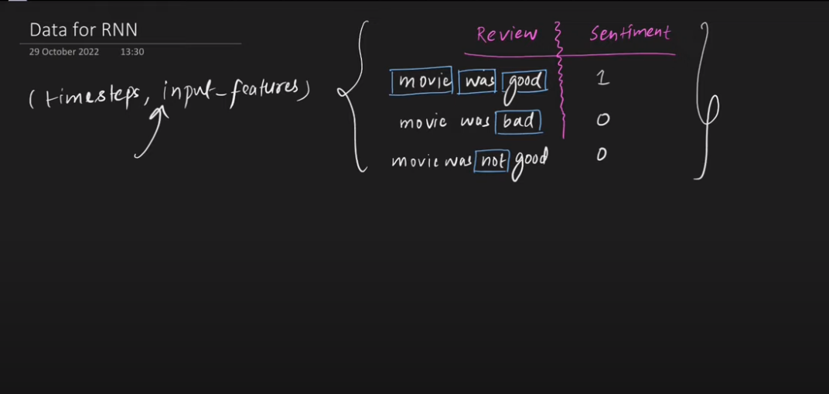

Slide 31
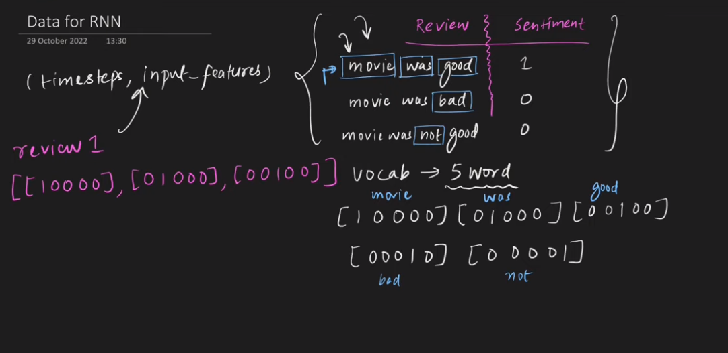

Slide 32
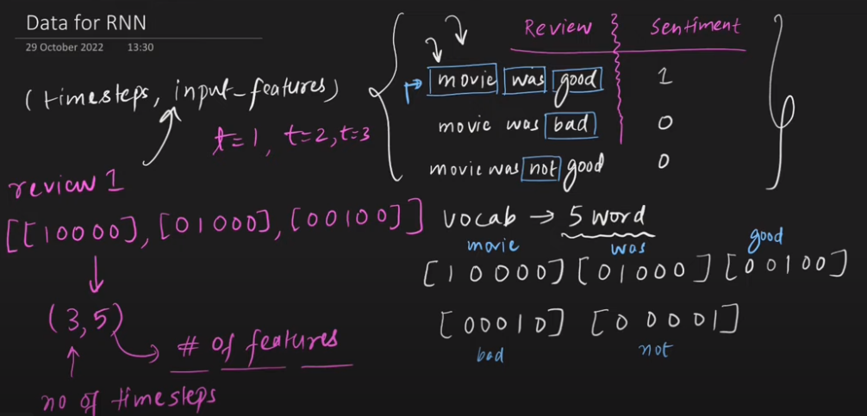

Slide 33
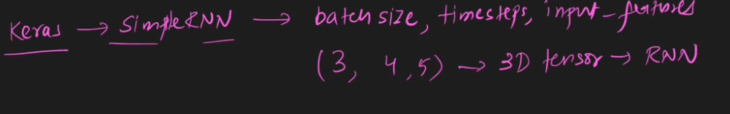

Slide 34
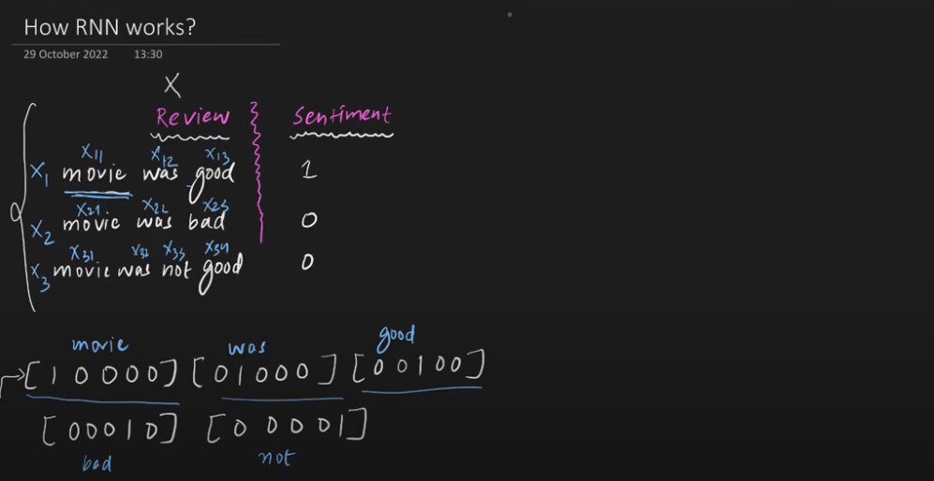

Slide 35
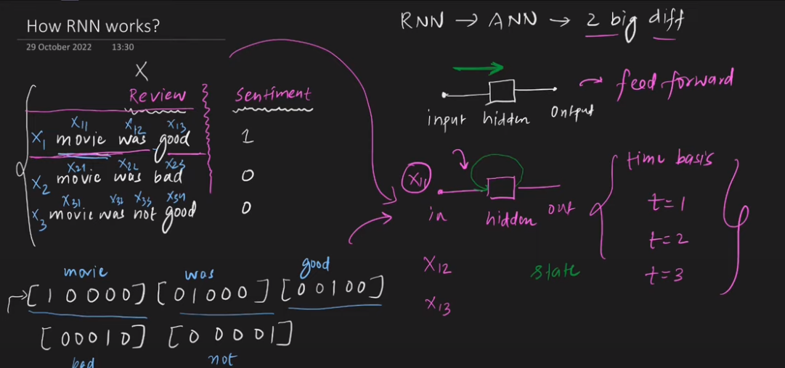


Slide 36
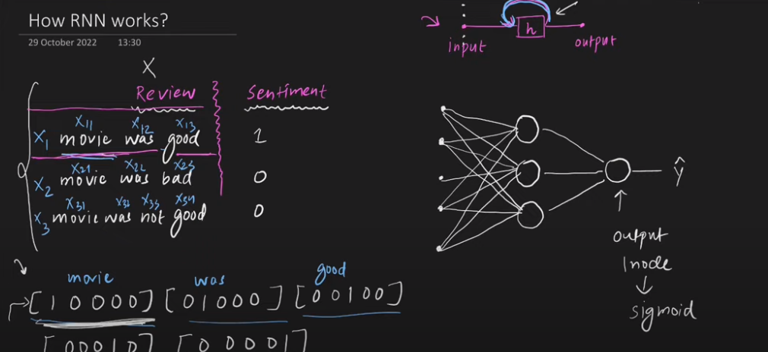

Slide 37
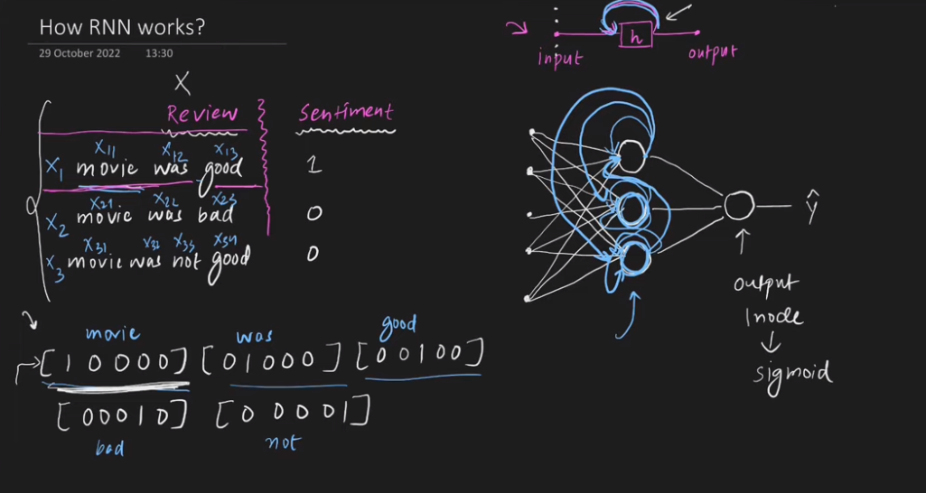

Slide 38
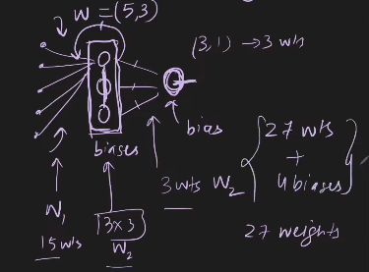

Slide 39
